Slide 1
Welcome to year 3/4
St Etheldreda class

Slide 2
Miss Hampton teaches English and Maths in the morning.
Mrs Sweetnam works with the class a lot.
Mrs Scott teaches the class in the afternoon along with year 5/6.
PE and music specialists also teach in the afternoon.
Senor Garcia teaches Spanish on a Friday.

Slide 3
Shameless school lunch plug!
Please do try our freshly prepared, healthy school lunches ☺

Slide 4
We will do a lot of outdoor learning, and we will use the marquee for assemblies and so on;
so please make sure your child has a warm coat when it is chilly. Wellies are also handy for
Forest School. (Tuesday and Thursday)
We may sometimes also take short local trips around the village and the local environment to
help stimulate our learning.
Please also ensure your child has correct PE kit in school. (Tuesday and Thursday)

Slide 5
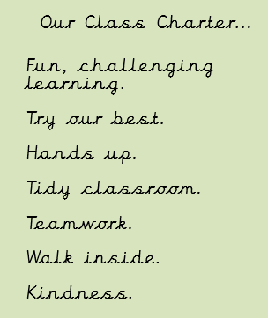
This is our class charter which we agreed as a class and summarises classroom expectations:

Slide 6
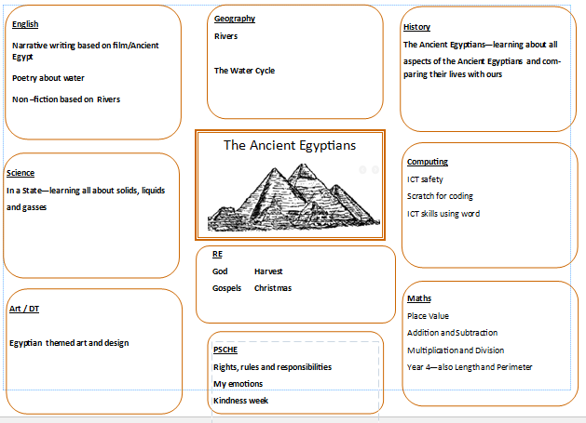
Curriculum overview –
Autumn term 2020

Slide 7
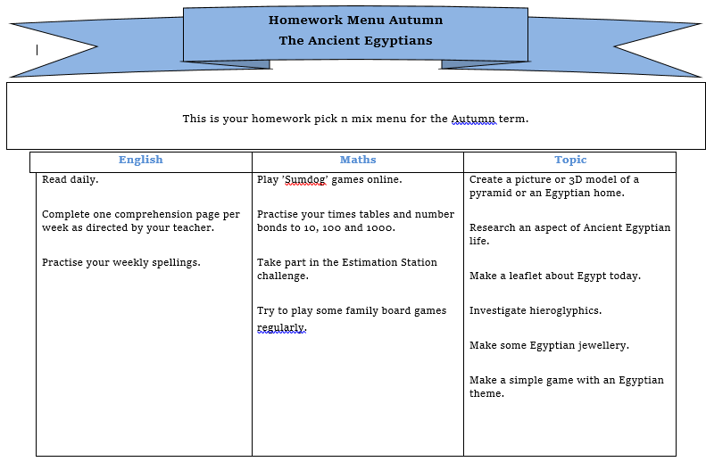
Homework overview and expectations

Slide 8
Communication
Please feel free to message me on class dojo. I will also post on class story once a week to
share what we have been up to in class. I will also put photos on the website from time to time.

