Slide 1
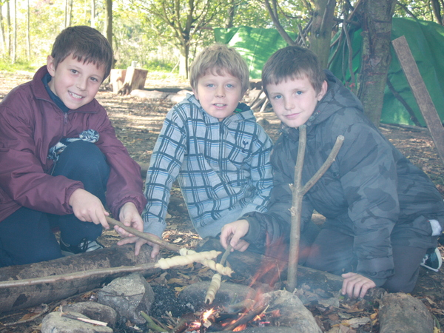
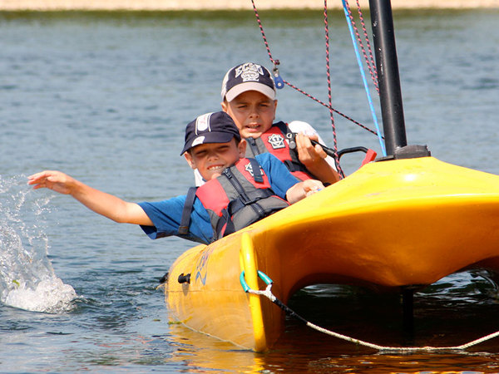
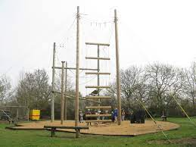
Grafham Water
Key Stage 2 trip
2023
21st-23rd June

Slide 2


How are we getting there?
To keep the costs down we are asking you to get your own children (can carpool) there and to collect them at the end. This has saved you a lot of money off the price of the trip. Any questions regarding this please speak to the office.
Your child will need to be at Grafham Water (Activity centre) at 10.30am on the Wednesday.
And will need collecting at 2pm on the Friday.

Slide 3
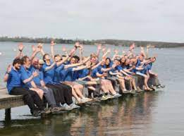
Which adults are going?
The children will be put into small groups and will be led by a member of staff from the centre.
Mrs Scarrow- leading the trip
Mrs Hegan
Mrs Sweetnam
Miss Corr- daytimes only

Slide 4
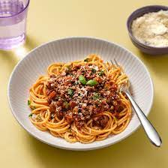

What will my child be eating?
ON THE WEDNESDAY THEY WILL NEED A PACKED LUNCH.
The children will eat in a cafeteria style dining room.
There is always more than one choice of main course.
Vegetarian options are available.
They cater for different allergies/intolerances.
They will get a snack halfway through the morning and afternoon.
Please can each child bring a packet of biscuits and 2 hot chocolate sachets, we will then share these in the evening around our fire pit.

Slide 5
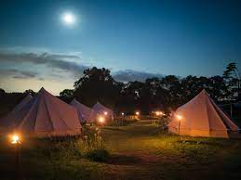
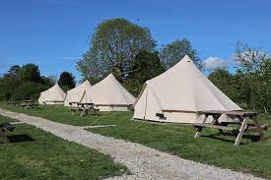
Where will my child be sleeping?
We will be sleeping in the bell tents (on mattresses), with access to fire pits.
Toilets, Changing and Shower facilities are located 50 meters from the tented village in the Sports Hall. They are fully heated and offer male, female and disabled changing spaces, toilets and showers.
The pathway between the tented village and the sports hall will be well lit with solar powered lighting and will be accessible.
Wet clothing can be left in the Sports Hall changing room to dry out.
A covered kitchen area is provided as part of the tented village with running water should groups need access to this during the night

Slide 6
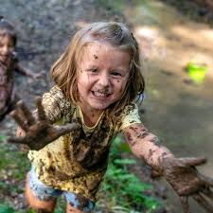
What will my child need to bring?
-sleeping bag
-pillow
-sun hat, woolly hat (fire pit)
-eye mask (it can get light early)
-Glasses strap
-sweaters/jumpers (not woollen)
-underwear
-swimwear (to wear under wetsuit)
-Shorts (not denim)
-warm trousers (preferably not jeans)
-indoor shoes (slippers)
-Outdoor shoes x 2(one for dry activities, one for wet activities)
-wellies
-shower towel x2
-water bottle
-washing kit
-evening casual wear
-suncream
-raincoat
-bin liners x 2
-torch
-£5max pocket money for souvenirs in a named envelope/purse to be handed in on arrival (small change)
-insect repellent
-book
-teddy
-medicines to be handed in on arrival (medical forms to be collected prior from the school office)
-no electrical devices

Slide 7
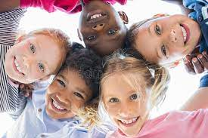
Who will my child be in a group with ?
The children have been asked to choose some friends that they would like to be.

Slide 8
Any other questions?

