Slide 1
Welcome to year 1/2 - St Julian class
Miss Hampton- 1/2 class teacher
Mrs Scarrow – Reception class teacher
Miss Pope - TA
Also…
Mrs Sweetnam, Miss Corr, Mrs Fairbairn, Mrs Vincent…

Slide 2
Please wear PE kit on PE Days (Monday and Thursday)
Forest School kit can stay in school (Monday PM and some Thursdays)
Main topics this term:
Mary Anning (dinosaurs)
Weather patterns in the UK
Materials
Animals
Creation story
Harvest and Christmas

Slide 3
How to support your child at home:
Daily reading…we learn to read so that we can read to learn!
Year One will have common exception words in their book bag.
Please practise reading these on a Monday, Tuesday Wednesday.
If your child is confident at reading them, please begin to practise spelling them.
On a Thursday your child will bring home their Little Wandle reading book.
Again, please practise reading this – daily if at all possible.
Year two will have an Accelerated Reader levelled book or a Little Wandle book
Please read this every day (if at all possible – at least 5x weekly).
Once they have read this book at home they will complete a quiz on the book and progress accordingly.
Year two children will also have some common exception words to practise reading and spelling.
Please practise these along side their AR reading book.
All children can also bring home a reading for pleasure book to share with adults at home.

Slide 4
Lots of information is available on the Little Wandle parents’ web page.
https://www.littlewandle.org.uk/resources/for-parents/
https://www.littlewandle.org.uk/everybody-read/parent-workshop-resources/

Slide 5
Maths at home…
chat about numbers, look for numbers when you are out and about,
cooking, board games…
Learn to tell the time – analogue and digital.
Maths ‘homework’ – number bonds on…
https://www.topmarks.co.uk/maths-games/hit-the-button
Topic homework –
See website class page.
One task per half term please.

Slide 6
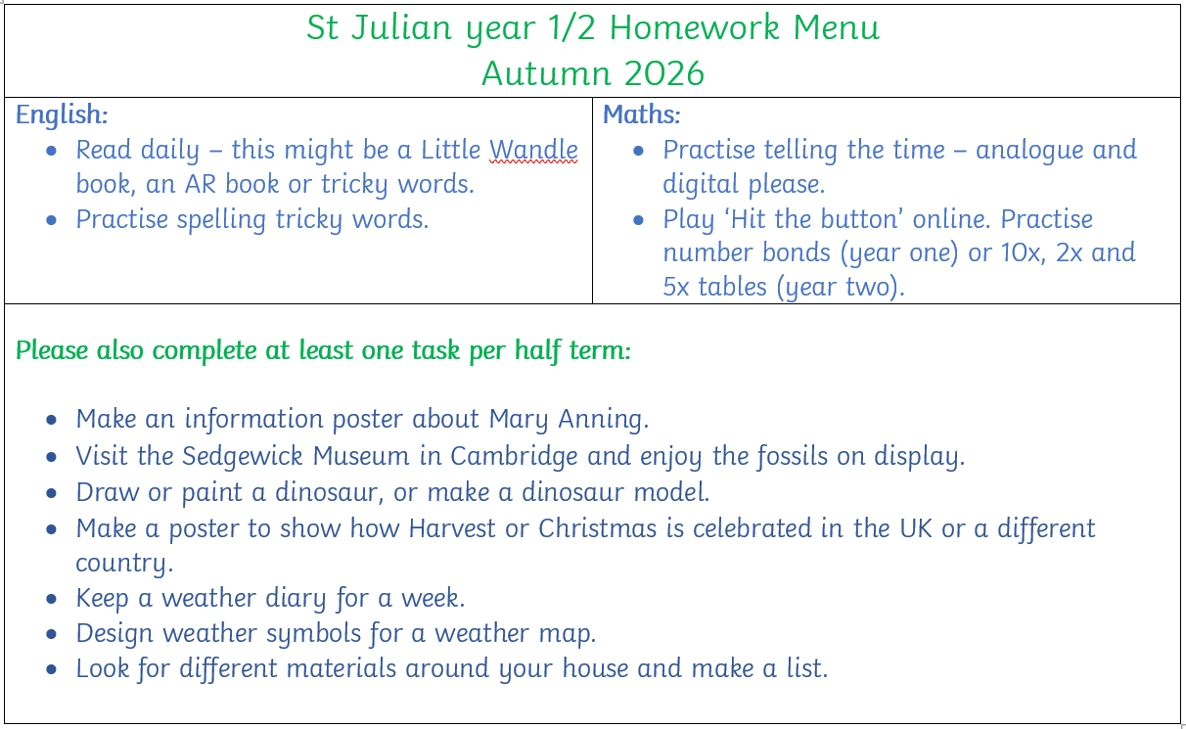

Slide 7
Year one Phonics Screening Check
Year two SATS

